Slide 1
Firebase Hosting
Lecturer: Ngo Huy Bien
Software Engineering Department
Faculty of Information Technology
VNUHCM - University of Science
Ho Chi Minh City, Vietnam
nhbien@fit.hcmus.edu.vn

Slide 2

Objectives
To deploy a Node.js application to Firebase Hosting.

Slide 3

Contents

Slide 4

References

Slide 5
Firebase Hosting
https://firebase.google.com/docs/hosting
Firebase Hosting provides fast and secure hosting for your web app, static and dynamic content, and microservices.
Install the Firebase CLI.
Set up a project directory. Add your static assets to a local project directory, then run firebase init to connect the directory to a Firebase project.
Run firebase emulators:start to emulate Hosting and your backend project resources at a locally hosted URL.
Run firebase deploy to upload the latest snapshot to our servers. By default, every Firebase project has free subdomains on the web.app and firebaseapp.com domains.

Slide 6
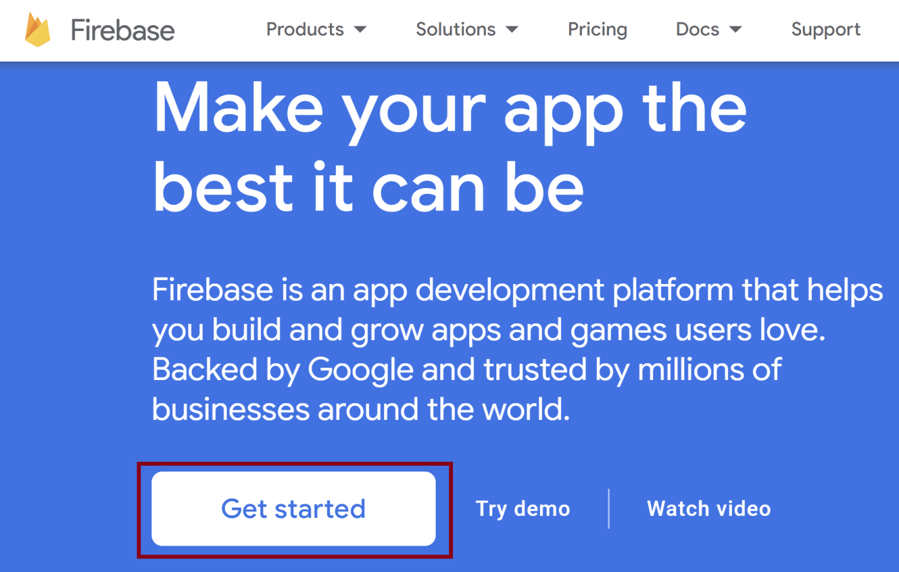
1. Click Get started
https://firebase.google.com/

Slide 7
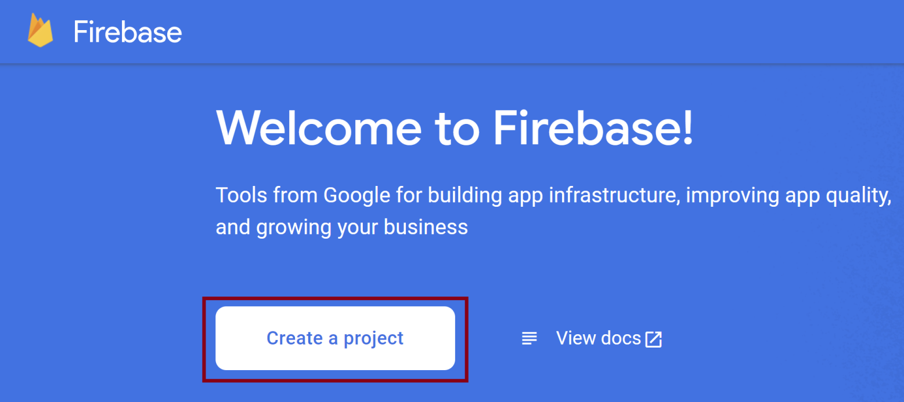
2. Create a Project

Slide 8
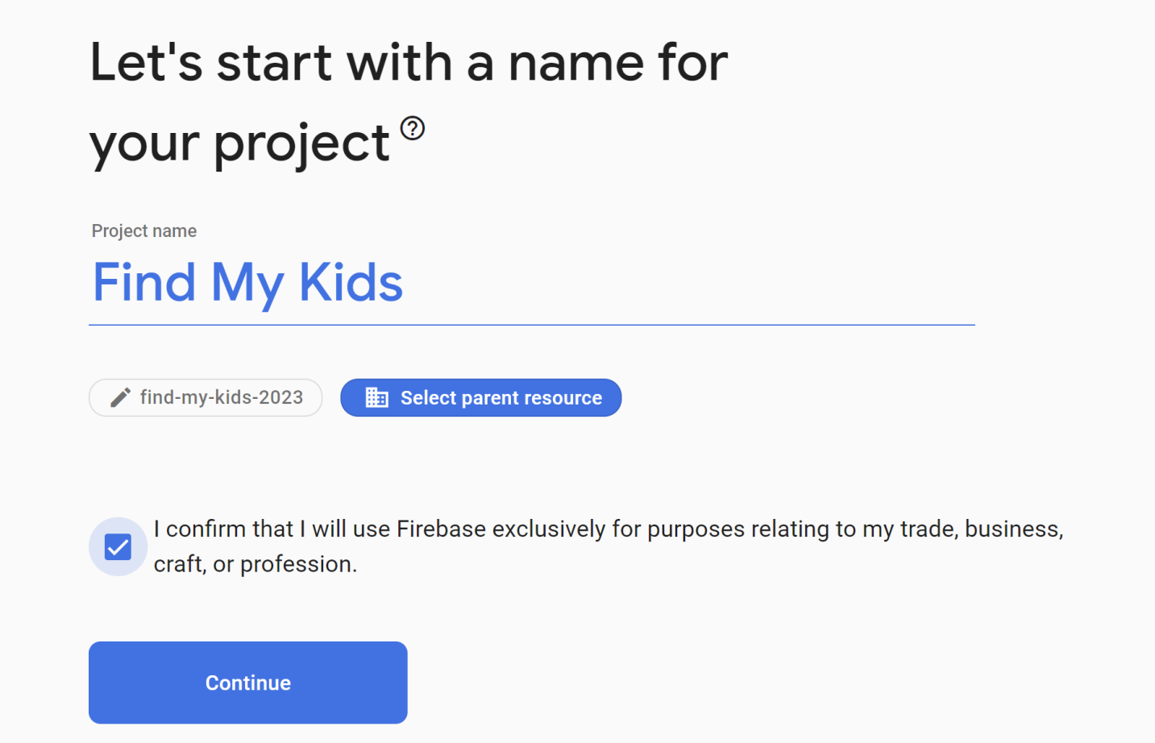
3. Enter a Project Name

Slide 9
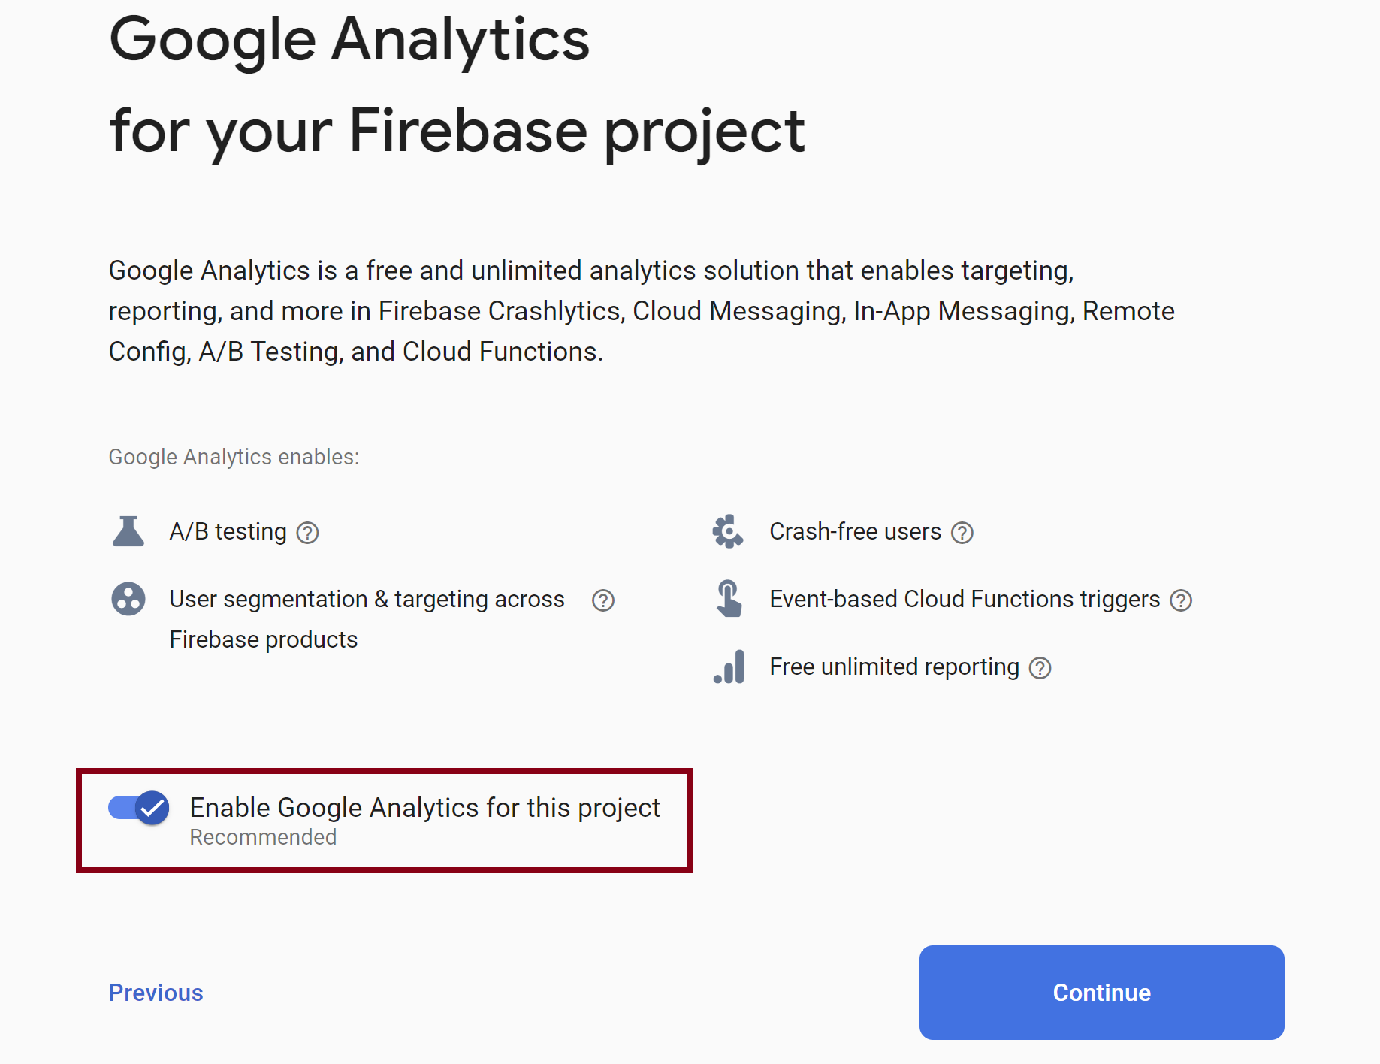
4. Enable Google Analytics

Slide 10
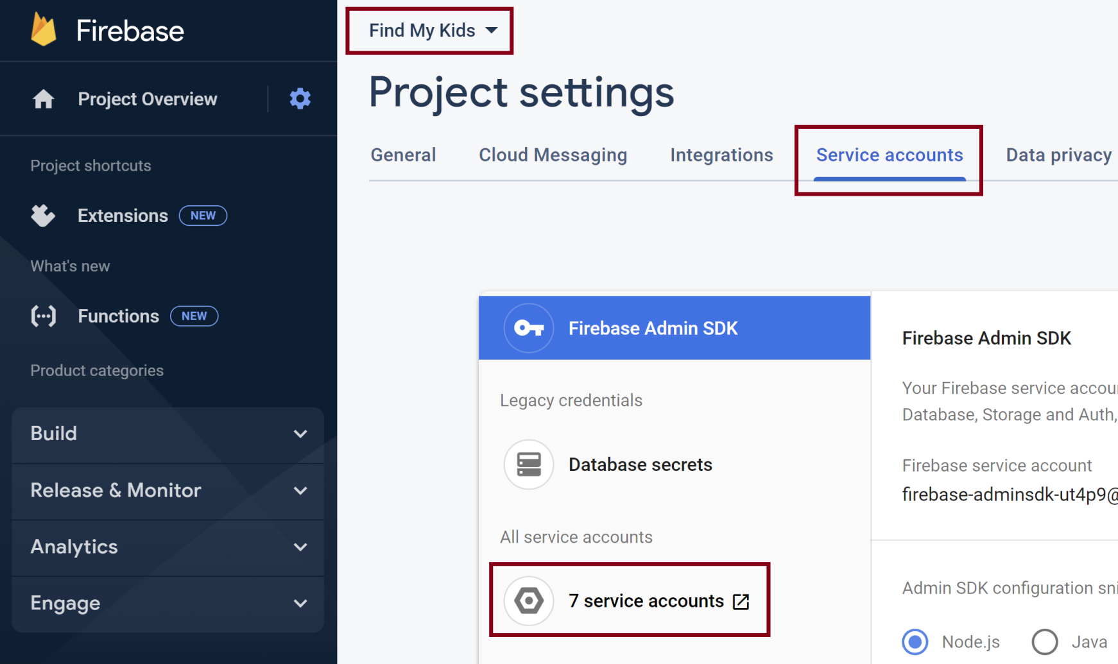
5. Go to IAM

Slide 11
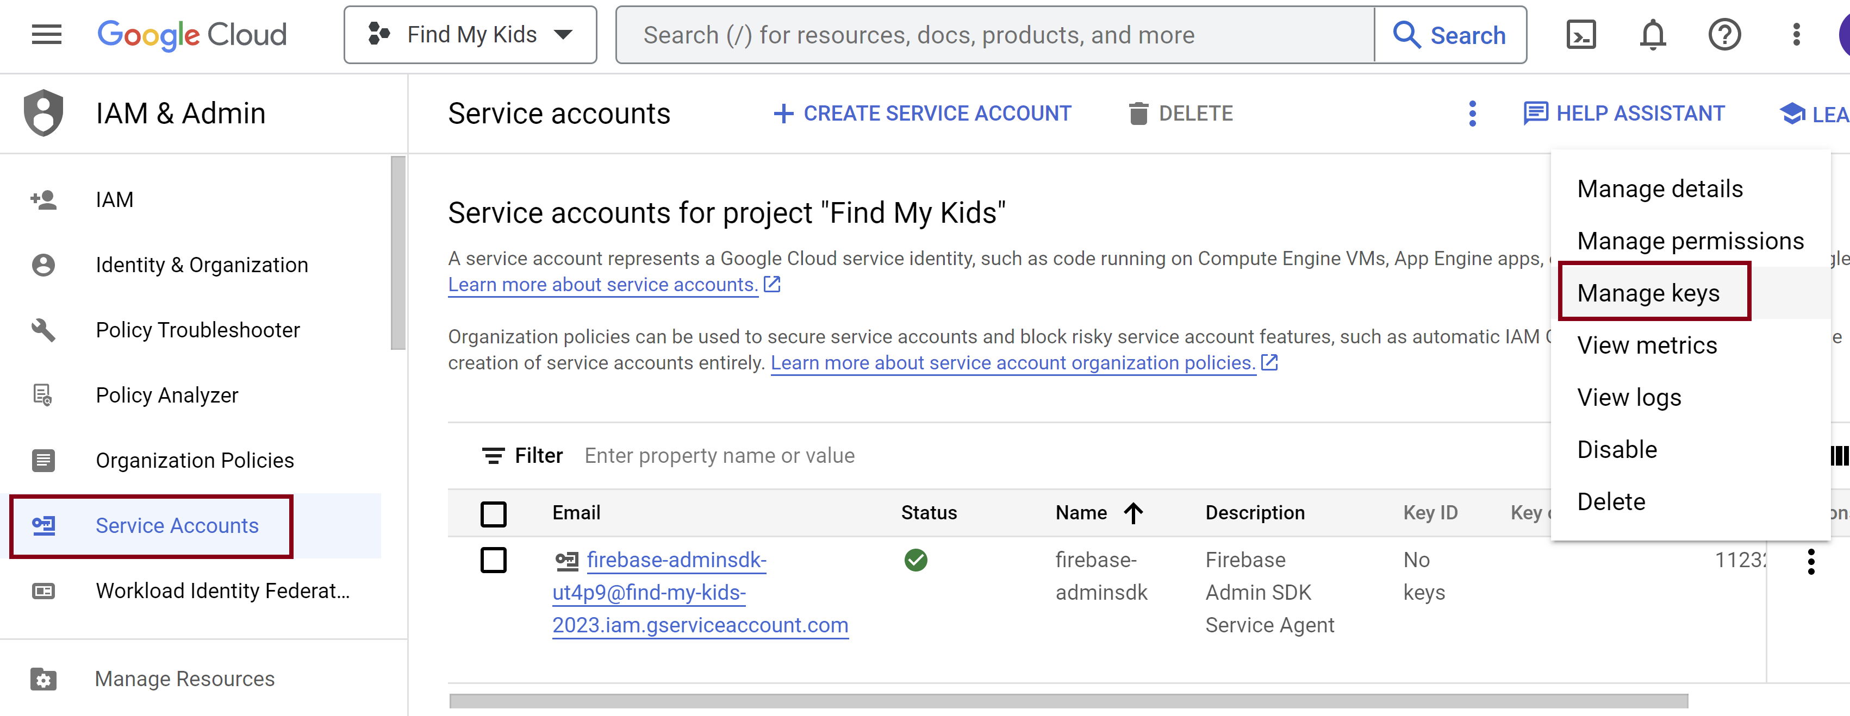
6. Go to Service Accounts

Slide 12
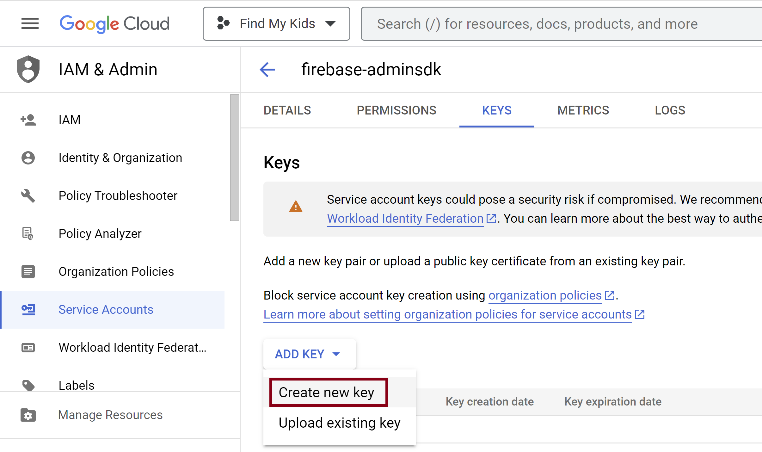
7. Create a New Key

Slide 13
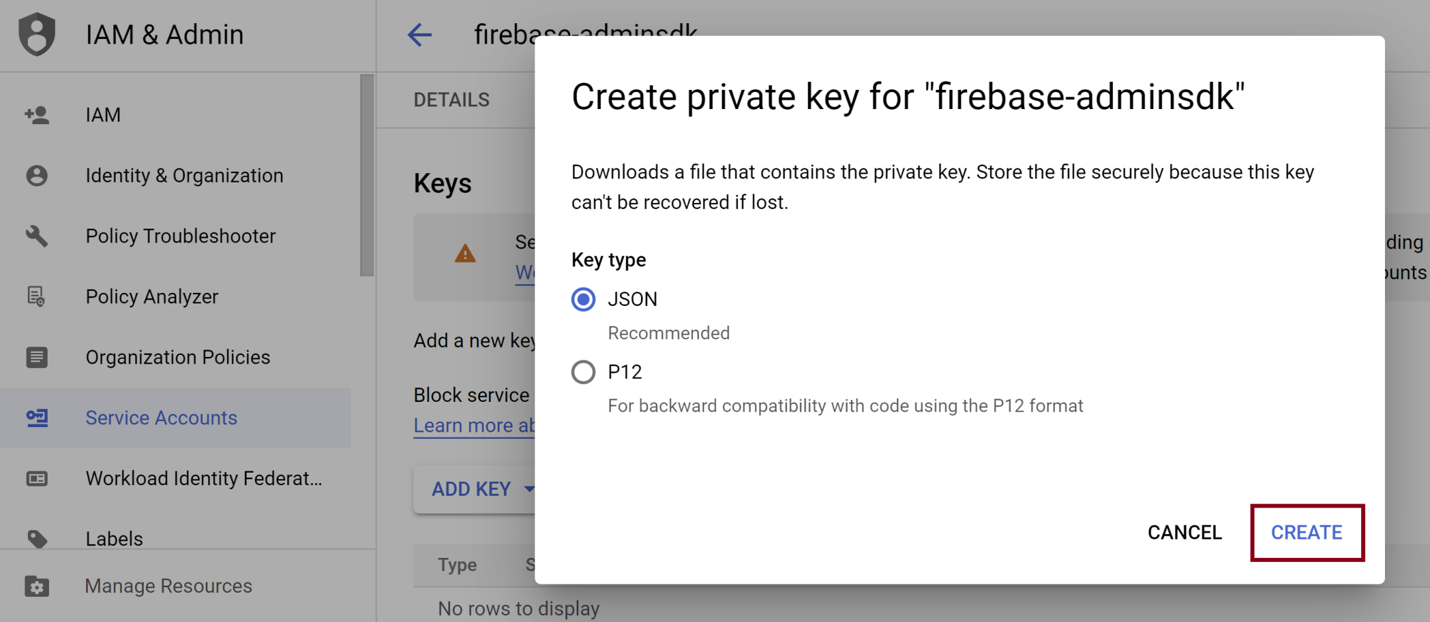
8. Download Private Key

Slide 14

Thank You & See You Again

